Slide 1


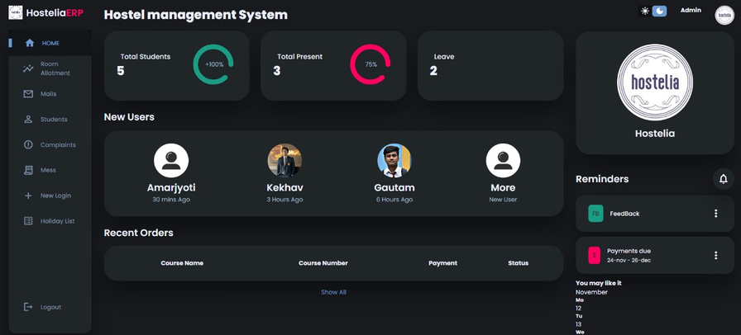
HOSTELIA
HOSTEL MANAGEMENT SYSTEM
A COMPREHENSIVE SYSTEM FOR EFFICIENT HOSTEL OPERATIONS
PRESENTATION BY
Amarjyoti Gogoi ( CS22BCAGN009 )
Kekhav Sonowal ( CS22BCAGN014 )
Gautam Paik ( CS22BCAGN023 )

Slide 2
INTRODUCTION
A Hostel Management System (HMS) is designed to automate and manage various hostel operations like student registrations, room allotment, fee management, attendance tracking, and complaint handling. It helps administrators manage hostels efficiently while providing students with a user-friendly interface to interact with the system.

Slide 3
PROBLEM STATEMENT
Challenges without an Hostel Management System:
Manual processes are time-consuming.
2.Difficulty in tracking student records and room availability.
3.Inefficient payment tracking.
4.Lack of centralized data management.
5.Difficulty in maintaining transparent communication
between students and administration.

Slide 4
PROJECT OBJECTIVES
To automate hostel management tasks such as room allocation, fee collection, attendance monitoring, and reporting.
2. To develop a user-friendly interface for
both students and administrators.
3. To ensure secure and centralized data storage.
4. To minimize human intervention and errors in the
management process.

Slide 5

TECHNOLOGIES USED
MongoDB:
Database to store property and booking information.
Express.js:
Database to store property and booking information.
React.js:
Frontend framework for building user interfaces.
Node.js:
Backend environment for running javascript on the server.

Slide 6
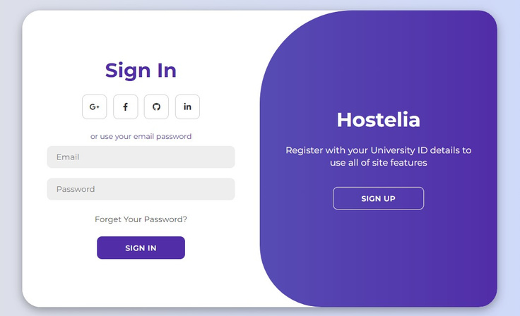
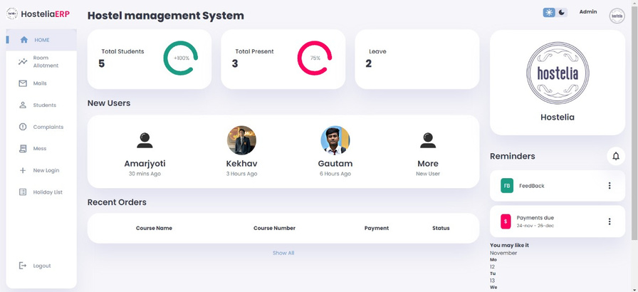
FRONTEND DEMO
Registration and login forms:
Student can create account & login.
Landing page:
User-friendly homepage/dashboard.

Slide 7
FUTURE WORKS
Backend Integration.(using Node.js with Express.js)
Database Integration (using MongoDB).
Implementing A.I.
Enhancing UI & UX.
Integrating Campus and Hostel maps.

Slide 8
CONCLUSION
In conclusion, the Hostel Management System project successfully addresses the various challenges faced in managing hostel operations, including room allocation, fee management, attendance tracking, and student record maintenance. Through the implementation of an intuitive and efficient software solution, the system streamlines these processes, reducing manual effort and minimizing errors. The use of modern technologies has enhanced the system's scalability, security, and user experience, making it an ideal tool for educational institutions.
By automating routine tasks, the Hostel Management System enables hostel administrators to focus on more strategic responsibilities, improving overall management efficiency. The system also provides students and staff with easy access to relevant information, such as room availability, billing details, and attendance status, thus fostering greater transparency and communication.

Slide 9
THANK YOU!
For being here with us.

